Slide 1
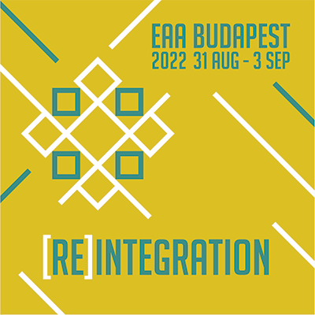

Developing best practices for an open library of archaeological ABM modules
Lessons learned from other initiatives
A. Angourakis, F. Riede, I. Romanowska, P. Verhagen, M. Saqalli,
D. Taelman, M. Vlach, K. Sikk, J.M. Galán, T. Brughmans

Slide 2
Outline
Other experiences
Code libraries
Simulation platforms
Other open science/source/data initiatives
Best practices principles
Collaboration
Workflow
Impact and sustainability
Our choices (so far)
On code
On metadata
On documentation
On version control and submission management
Open questions

Slide 3
1.
Other experiences

Slide 4
1.1.
Code libraries
CoMSES Model library - https://www.comses.net/
NetLogo User Community Models - https://ccl.northwestern.edu/netlogo/models/community/
R CRAN - https://cran.r-project.org/
NASA Open Source Software - https://code.nasa.gov/
Domain-specific
Agriculture:
Decision Support System for Agrotechnology Transfer (DSSAT) - https://dssat.net/
SWAT - https://swat.tamu.edu/
Physics:
MechSys - https://mechsys.nongnu.org/index.html
Notes:
CoMSES - https://www.comses.net/resources/guides-to-good-practice/ ; https://doi.org/10.1016/j.envsoft.2014.06.022

Slide 5
1.2.
Simulation platforms (for or including ABM)
Libraries/packages (no stand alone, no GUI):
SimPy (Python) - https://simpy.readthedocs.io/en/latest/contents.html
Mesa (Python) - https://mesa.readthedocs.io/
Agents.jl (Julia) - https://juliadynamics.github.io/
LSD (C++) - https://www.labsimdev.org/wp/
Free & Open-source platforms:
NetLogo - https://ccl.northwestern.edu/netlogo/
Repast - https://repast.github.io/
MASON - https://cs.gmu.edu/~eclab/projects/mason/
GAMA - https://gama-platform.org/
TurtleSpaces - https://turtlespaces.org/
PhET Interactive Simulations - https://phet.colorado.edu/
Commercial platforms:
AnyLogic - https://www.anylogic.com/
MathWorks’ Simulink - https://www.mathworks.com/solutions/system-design-simulation.html?s_tid=hp_solutions_system

Slide 6
1.3.
Other open science/source/data initiatives
Archaeological data:
Journal of Open Archaeological Data - https://openarchaeologydata.metajnl.com/
The Digital Archaeological Record (tDAR) - https://core.tdar.org/
Archaeological Data Service (ADS) - https://archaeologydataservice.ac.uk/
ARIADNE EU - https://www.ariadne-eu.org/
Generic data repositories:
Zenodo - https://zenodo.org/
Open Science Foundation (OSF) - https://osf.io/
Humanities Commons - https://hcommons.org/
Wikipedia (Wikimedia Foundation) - https://wikimediafoundation.org/
Git hosts:
GitHub - https://github.com/
GitLab - https://about.gitlab.com/
Bitbucket - https://bitbucket.org/
Code Ocean - https://codeocean.com/

Slide 7
2.
Best practices principles

Slide 8
2.1.
Collaboration
Avoid overplan, overdo or oversell
Communication with “core” group
Communication with wider community (users/authors)
Single channel
Bureaucracy matching scale
Clarity of objective and TO-DOs
Clarity of roles
“Speak your truth”
Multiple channels
Inviting attitude
Clarity of achievements
Clarity of open roles
Notes:
Avoid overplan, overdo or oversell: keep long-term plans general and abstract enough to accomodate changes along the way. Do not advance activities too much without checking how they lead to the main objectives. Do not sell too much to the wider community those outcomes that are still to be fully accomplished.
Core group (currently engaging members)
Single channel
Bureoucracy matching scale: organisation roles must be balanced by the effective commitment and number of member in the core group
Clarity of objective and next steps: all core members must hold a clear notion of the main objectives and which are the currently to-dos.
Clarity of roles: members in the core group must know their current role (domain of tasks) and those of others. Keep roles and tasks separable and non-redundant.
“Speak your truth”: good communication of needs, ideas, convictions, etc, to avoid unecessary and unspoken defections
Network (dormant, unavailable or passive members)
Multiple channels: given a large enough community, there will be no single preferred channel for communication, so do not try to force one.
Inviting attitude: everyone has they priorities, and the core group should always keep a positive and open attitude towards the wider community. Gamification?
Clarity of achievements: everything done should be summarised and clearly expose to the wider community to help consolidate a perception of progress.
Clarity of open roles: the wider networks should be regularly informed about unfulfilled roles or potential roles in the core group

Slide 9
2.2.
Workflow
Progressive immediatism
Modularity of outcomes
Redundancy of outcomes
Minimise external dependency
Multilateral revision
Every closeable outcome must be packed and made available in the most open and publicly way possible.
Outcomes should be kept bite-sized and relatively separable from the other outcomes.
Do not discourage or correct the production of outcomes whose content overlap. It can help both the promotion and long-term sustainability of the redundant content.
Make so that the outcomes remain usable and useful despite potential changes in the larger infrastructure context. Detect fragilities and prepare contingencies.
Outcomes should be subjected to a peer-review process.
Notes:
Progressive immediatism: every closeable outcome must be packed and made available in the most open and publicly way possible.
Modularity of outcomes: outcomes should be kept bite-sized and relatively separable from the other outcomes.
Redundancy of outcomes: do not discourage or correct the production of outcomes whose content overlap. It can help both the promotion and long-term sustainability of the redundant content.
Minimise external dependency: Make so that the outcomes remain usable and useful despite potential changes in the larger infraestructure context. Detect fragilities and prepare contingencies.
Multilateral revision: outcomes are subjected to peer-review process

Slide 10
2.3.
Impact and sustainability
FAIR principles
Free open distribution
Target users
Indicators of use
Feedback
All data stored (code or else) should strive to be findable, accessible, interoperable, and reusable, as far as possible.
No financial transaction is involved in the submission and use of the library.
Define and aim for a target audience first, then expand if opportunities are encountered.
Measure use/access to the library. Get to know your actual users.
Query the community of users, especially long-timers, to set pathways for further improvements.
Notes:
https://twitter.com/HeidiBaya/status/1562028586760081409?s=20&t=OHqNrRByivhgPnPQ95W3NQ
FAIR principles
Free open distribution
Indicators: measure use/access of outcomes
Target users
Feedback: query community for possible improvements.

Slide 11
3.
Our choices (so far)

Slide 12
3.1.
On code
Naming
Single-responsibility principle
No magic numbers
Exposed inputs and outputs
Keep it basic (minimise dependencies)
Commentary in code
Notes:
Naming. Use consistent conventions to differentiate variables, parameters, and functions. Enforce explicit, self-explanatory names, avoid names imitating mathematical annotations. Exceptions could be made by compensating name simplification with more exhaustive commentary.
Single-responsibility principle. At the authors’ best capacity, the code should be modular, particularly if the contribution is relatively complex; e.g., if the module involves several types of entities or represents a process in several steps. (https://en.wikipedia.org/wiki/Single-responsibility_principle).
No magic numbers. 'Magic numbers' are numbers that occur in code without an explicit meaning and are not settable without altering the code. They should preferably be replaced by named variables, even if kept as constants. (https://en.wikipedia.org/wiki/Magic_number_(programming))
Exposed inputs and outputs. All variables named as either input or output of the module must be easily reachable in code from outside the module. This is in order to allow or facilitate the plug-and-play quality of modules.
Keep it basic. Modules should minimise the use of third-party libraries, packages, etc, as much as possible. It is especially important to avoid any software relatively hard to obtain or set up. Dependencies are always a risk for reproducibility and code sustainability in the long run.
Commentary in code. Be repetitive and explain language-specific (not easily searchable) functions, if possible. Expand information whenever relevant, e.g., offering a source (preferably, hyperlink) or explaining the logic behind a hardcoded or suggested parameter value. Add full references (with web link if available, of the sources used to inform the design of an algorithm or set parameter values. If there are any code fragments “commented-out”, use a clear and consistent way to differentiate these from actual comments

Slide 13
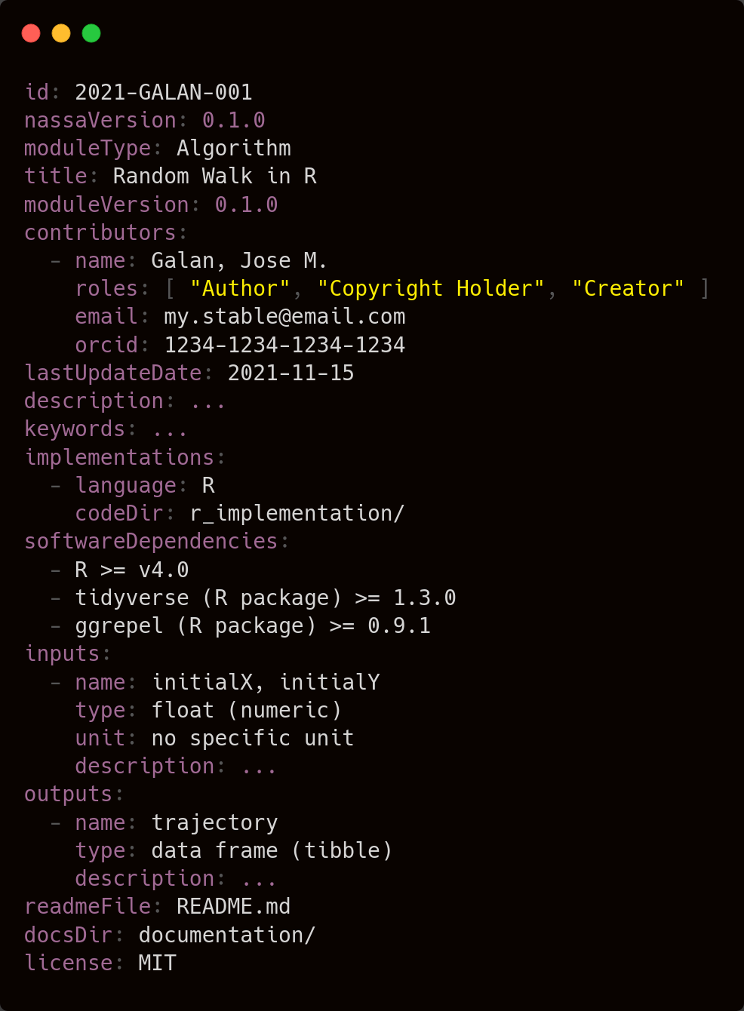
3.2.
On metadata
The NASSA.yml file:
A central configuration file that defines the module as a unit
Contains all relevant meta-information in a well-specified format
Allows for both minimal requirements and progressive editing
Machine- and human-readable in the YAML language
Can be used to auto-generate a module page (Rmarkdown-HTML)
Semantic tagging (archaeological & modelling)
Modular licencing
Notes:
Metadata: Metadata is to be contained in the “NASSA.yml” file, placed at the root directory of the module, as exemplified in the templates. (bring here the field descriptions table and an example)
Modular approach to licencing, allowing certain freedom of choice to module authors, as long as the licence is open source

Slide 14
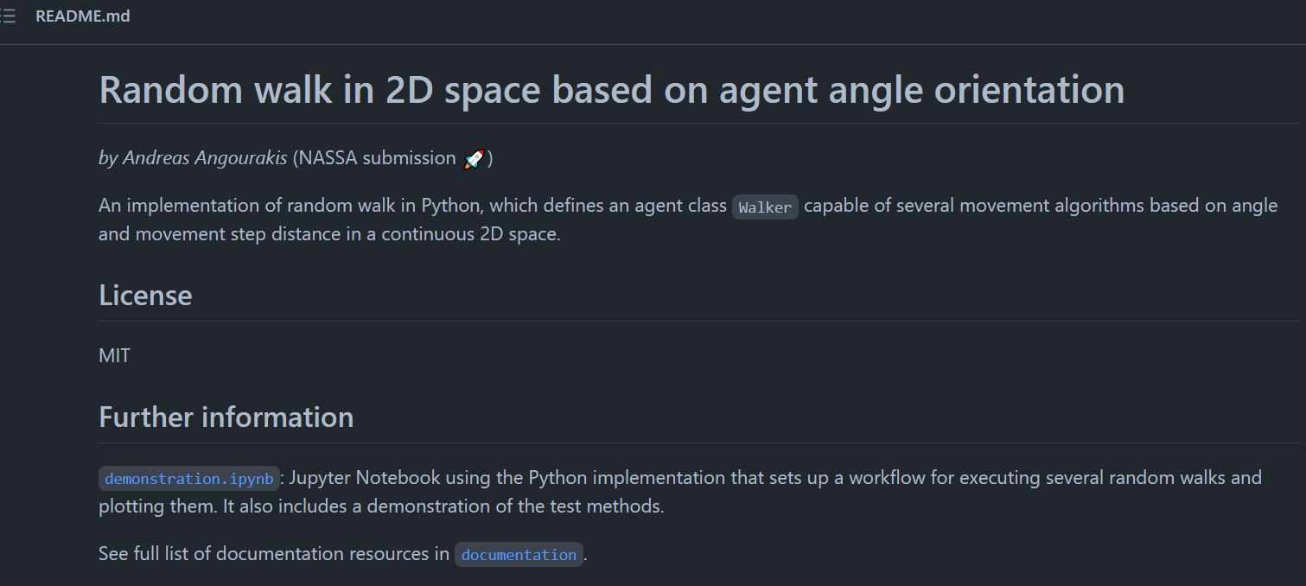
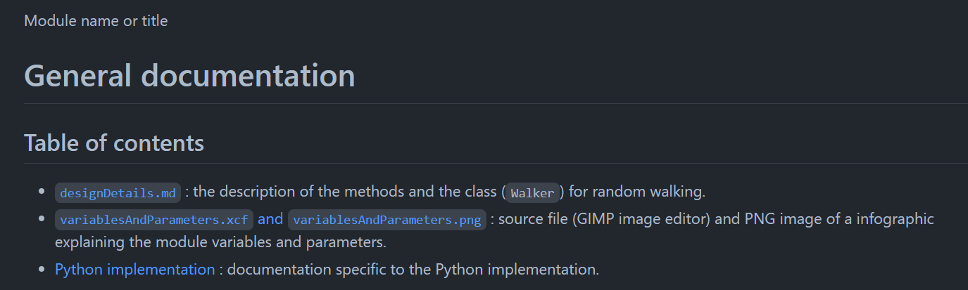
3.3.
On documentation
The README.md file:
Human readable free text presenting the module
Includes title, author, version, etc.
Hyperlinks to documentation and demonstration materials
Can be used in the generation of a module page (HTML)
Variable lists, diagrams, pseudocode
Screenshots
Demonstrations, tutorials
Additional documents (ODD?)
Notes:
Documentation: Files to be placed in the “documentation” subdirectory, placed at the root directory of the module, as exemplified in the templates.
Readme.md: Including at least the required metadata fields, such as name/title, authors, etc, and any additional info added in “Design details and justification” (maybe we could generate it automatically by scrapping contents of the database fields after the contribution is submitted, and a form filled?). It can potentially serve as the webpage of the module. Preferably, the author should display here some of the visual elements offered, such as pseudocode diagrams, screenshots, output graphs in demonstrations, etc (see below).
Pseudocode: Representation of code as a sequence of logic steps (i.e. algorithm), using free-text or mathematical notation, or using graphical resources, be it formal (e.g. UML) or informal (e.g. infographics).
Screenshot of the interface, if applicable.
Demonstration. A demonstration of the module use and outputs, combining explanations in text and code fragments, typically in a notebook format (e.g., .ipynb, .rmd).
Additional documents: (should we define a document in the style of ODD? maybe just for submodels? refer to our discussions in “Standards_2021-11-08.docx”)

Slide 15
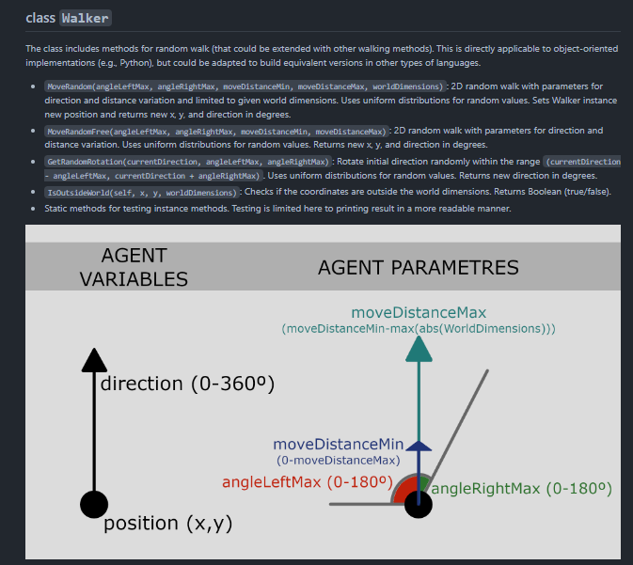
3.3.
On documentation
The README.md file:
Human readable free text presenting the module
Includes title, author, version, etc.
Hyperlinks to documentation and demonstration materials
Can be used in the generation of a module page (HTML)
Variable lists, diagrams, pseudocode
Screenshots
Demonstrations, tutorials
Additional documents (ODD?)
Notes:
Documentation: Files to be placed in the “documentation” subdirectory, placed at the root directory of the module, as exemplified in the templates.
Readme.md: Including at least the required metadata fields, such as name/title, authors, etc, and any additional info added in “Design details and justification” (maybe we could generate it automatically by scrapping contents of the database fields after the contribution is submitted, and a form filled?). It can potentially serve as the webpage of the module. Preferably, the author should display here some of the visual elements offered, such as pseudocode diagrams, screenshots, output graphs in demonstrations, etc (see below).
Pseudocode: Representation of code as a sequence of logic steps (i.e. algorithm), using free-text or mathematical notation, or using graphical resources, be it formal (e.g. UML) or informal (e.g. infographics).
Screenshot of the interface, if applicable.
Demonstration. A demonstration of the module use and outputs, combining explanations in text and code fragments, typically in a notebook format (e.g., .ipynb, .rmd).
Additional documents: (should we define a document in the style of ODD? maybe just for submodels? refer to our discussions in “Standards_2021-11-08.docx”)

Slide 16
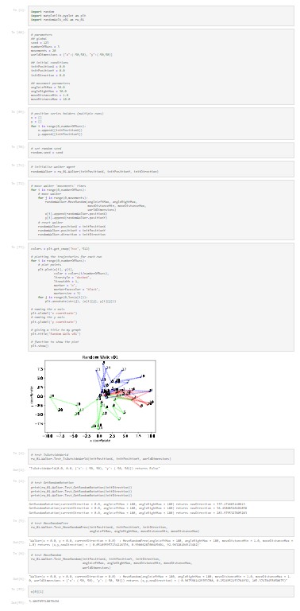
3.3.
On documentation
The README.md file:
Human readable free text presenting the module
Includes title, author, version, etc.
Hyperlinks to documentation and demonstration materials
Can be used in the generation of a module page (HTML)
Variable lists, diagrams, pseudocode
Screenshots
Demonstrations, tutorials
Additional documents (ODD?)
Notes:
Documentation: Files to be placed in the “documentation” subdirectory, placed at the root directory of the module, as exemplified in the templates.
Readme.md: Including at least the required metadata fields, such as name/title, authors, etc, and any additional info added in “Design details and justification” (maybe we could generate it automatically by scrapping contents of the database fields after the contribution is submitted, and a form filled?). It can potentially serve as the webpage of the module. Preferably, the author should display here some of the visual elements offered, such as pseudocode diagrams, screenshots, output graphs in demonstrations, etc (see below).
Pseudocode: Representation of code as a sequence of logic steps (i.e. algorithm), using free-text or mathematical notation, or using graphical resources, be it formal (e.g. UML) or informal (e.g. infographics).
Screenshot of the interface, if applicable.
Demonstration. A demonstration of the module use and outputs, combining explanations in text and code fragments, typically in a notebook format (e.g., .ipynb, .rmd).
Additional documents: (should we define a document in the style of ODD? maybe just for submodels? refer to our discussions in “Standards_2021-11-08.docx”)

Slide 17
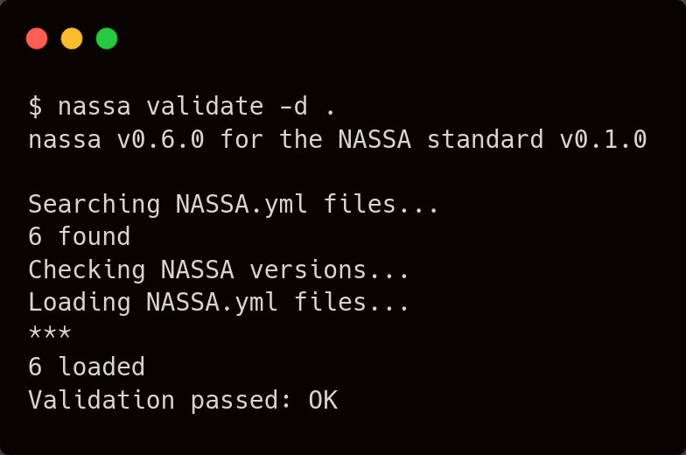
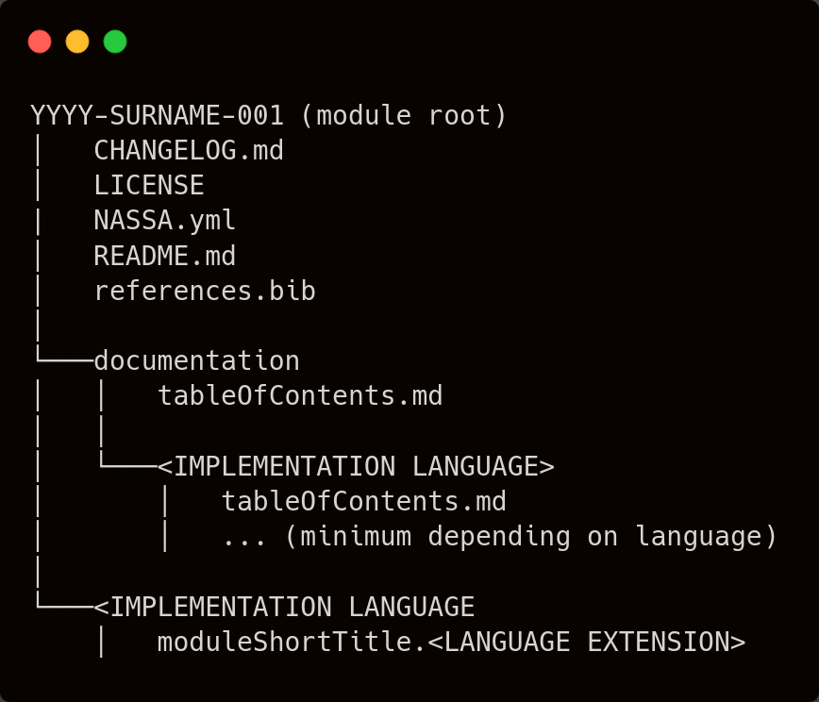
3.4.
On version control and submission management
Nassa module submitted as (part of) GitHub repository:
https://github.com/Archaeology-ABM/NASSA-modules
https://github.com/Archaeology-ABM/nassa-hs
Software to automatically validate structure and metadata of submitted modules (Haskell)
A clearly defined, versioned definition, of the NASSA module structure(currently v0.1.0)
Really not possible without Clemens Schmid!
https://github.com/Archaeology-ABM/NASSA-schema
Notes:
Versioning: All changes in the module files must be reflected in their version number and noted in the log file (“CHANGELOG.txt”). (explain a standard for version numbering) (explain how to edit the CHANGELOG.txt; get it from Poseidon’s example) (make explicit recommendations for creating and maintaining modules in GitHub, or at least under version control, independently of the library storage after submission; maybe we should discuss how exactly we expect submissions to be made)

Slide 18

Open questions
Thank you
and…
More examples/models to follow?
More/alternative best practice principles?
Practical suggestions towards a better NASSA library?
site: https://archaeology-abm.github.io/NASA
repository: https://github.com/Archaeology-ABM

